Slide 1

Gokhale Education Society’s
R.H. Sapat College of Engineering, Management Studies & Research
Department of Electronics & Telecommunication Engineering
Seminar on Mini Project
T. E. E&TC
Face Mask Detector
Presented by:
Gaikwad Rohit
Bagul Ashish
3. Maharshi Yadnesh
Under the guidance of
Prof. P. D. Lokhande

Slide 2
Contents:
Introduction
Literature Survey/Review
Problem Statement
Objective
Proposed System and its Overview
Hardware Requirement
Software Requirement
Block Diagram and Flowchart
Circuit Diagram
Applications
Cost Estimation
Advantages
Scope of Project
Conclusion
Reference
Face Mask Detector 2

Slide 3
Introduction:
From the last two years, COVID-19 has spreading across the world. It is important to check whether everyone has wore a face mask or not in public places.
To overcome such problem, we have designed a system ‘Face Mask Detector’ which is used to monitor without human intervention.
With the use of deep learning, higher accuracies in face detection and face recognition can be acquired.
This process is completely automatic and there is no need of any physical interaction. Therefore this surely saves time and human efforts .
Face Mask Detector 3

Slide 4
Literature Survey:
Year | Author Name | Title | Conference | Conclusion
2019 | Yukai Shi, Guanbin Li, Qingxing Cao, Keze Wang, Liang Lin | Face Hallucination by Attentive Sequence Optimization with Reinforcement Learning | Transactions on Pattern Analysis and Machine Intelligence (TPAMI) | Gives algorithms to solve face hallucination problem in face detection using model training.
2020 | Tanvir Ahmed, Prangon Das, Md. Firoj Ali, Md- Firoz Mahmud | A Comparative Study on Convolutional Neural Network Based Face Recognition | 11th International Conference on Computing, Communication and Networking Technologies (ICCCNT) | Presents a study to recognize faces from a customized dataset of 10 identities of different celebrities using Convolutional Neural Network.
2020 | Truong Quang Vinh, Nguyen Tran Ngoc Anh | Real Time Face Mask Detector with YOLOv3 Algorithm & Haar Cascade Classifier | International Conference on Advanced Computing and Applications (ACOMP) | Detects face mask using YOLOv3 algorithm and Haar Cascade classifier.
2021 | M Rohini, K.R Naveena, G Jothipriya, S Kameshwaran, M Jagadeeswari | A Comparative Approach To Predict Corona Virus Using Machine Learning | International Conference on Artificial Intelligence and Smart Systems (ICAIS) | Gives machine learning algorithm using Support Vector Machines and KNN algorithm.
2020 | Wuttichai Vijitkunsawat; Peerasak Chantngarm | Study of the Performance of Algorithms for Face Mask Detection | 5th International Conference on Information Technology (InCIT) | Proposes a system ‘MFD’ using IMX-219 Camera module and AI processing.
Face Mask Detector 4

Slide 5
Problem Statement:
COVID-19 is the greatest challenge in front of mankind. According to the WHO, COVID-19 disease spreads through corona virus from infected person to anyone by the droplets of saliva or liquid particles. So at places where major number of people are gathering, it is mandatory to check everyone has wear a mask or not.
It is very challenging to do this process by any person where large number of people enter and pass. We can create solution of this problem using electronics system by detecting the mask availability of all the people individually.
Face Mask Detector 5

Slide 6
Objectives of Proposed Project:
To develop an Arduino based Face Mask Detector system which can check the person has wore a face mask or not.
To develop a system which shows a message turning on LED that a person has wore a face mask.
Face Mask Detector 6

Slide 7
System Overview:
The Face Mask Detector is totally based on the function and working of ESP32 CAM. A program code is needed to be inserted in ESP32 CAM to run the circuit.
First of all, the person should stand in front of the system and should look at the camera module.
The person's face will be scanned by camera module and face mask is detected using the source code.
If mask detected then green LED will glow. This is how the system shows output.
Face Mask Detector 7

Slide 8
Problem Definition
It requires a lot of time and human efforts to determine each and every person in the crowd has wore a mask or not and then separate out them. This task should be made easy.
This requires a solution which uses automatic technology to save time and efforts.
Face Mask Detector 8

Slide 9
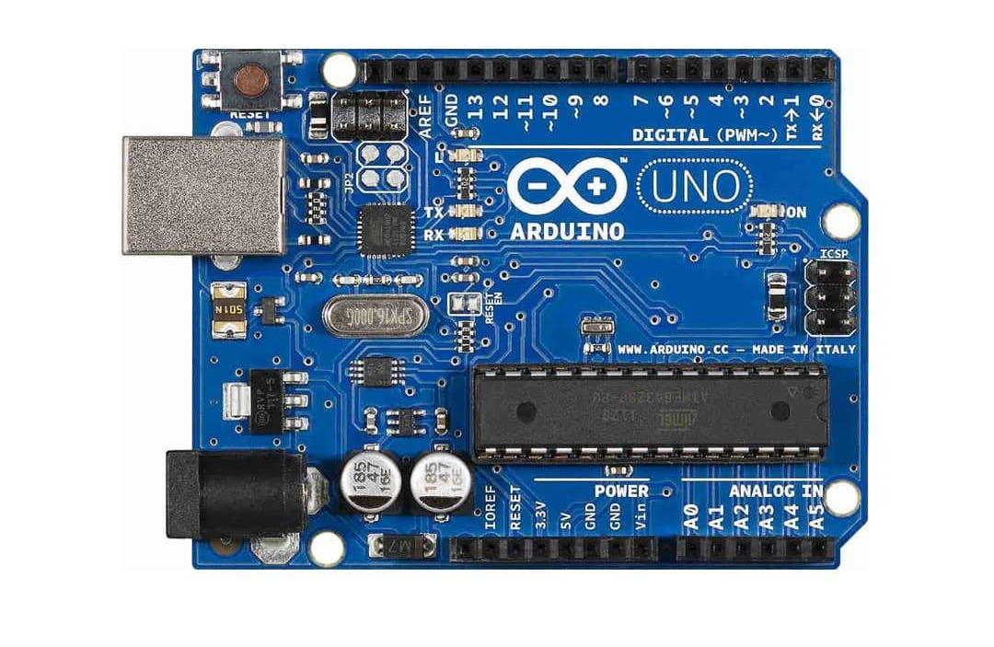
Hardware Requirements
Arduino Uno
Face Mask Detector 9

Slide 10
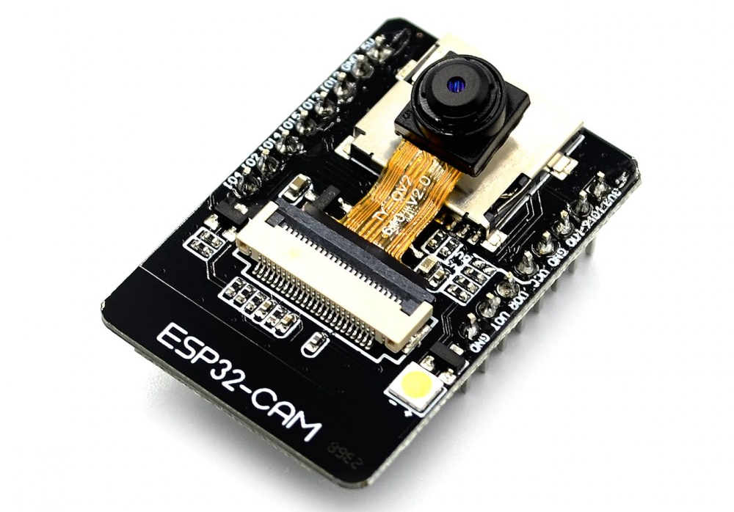
Hardware Requirements
ESP32 CAM
Face Mask Detector 10

Slide 11
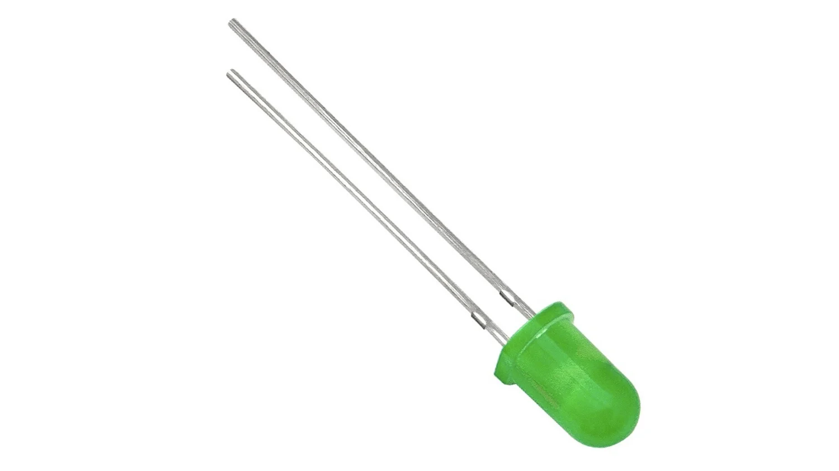
Hardware Requirements
Green LED
Face Mask Detector 11

Slide 12
Software Requirements
Fritzing
Proteus
Arduino IDE
Face Mask Detector 12

Slide 13
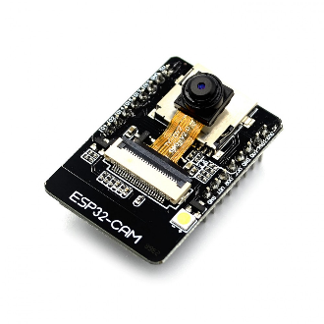
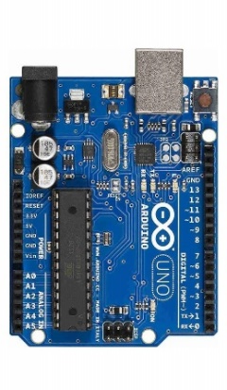
Block Diagram
Power Supply
ESP32 CAM
Green LED
Arduino Uno
Face Mask Detector 13

Slide 14
Flowchart
Initialize Webcam ESP32 CAM
Mask Detected
Yes
Green LED
Face Mask Detector 14

Slide 15
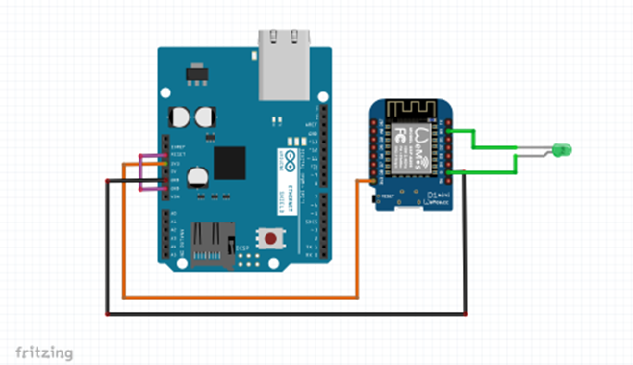
Design of Proposed System:
Hardware Design: Circuit Diagram
Face Mask Detector 15

Slide 16
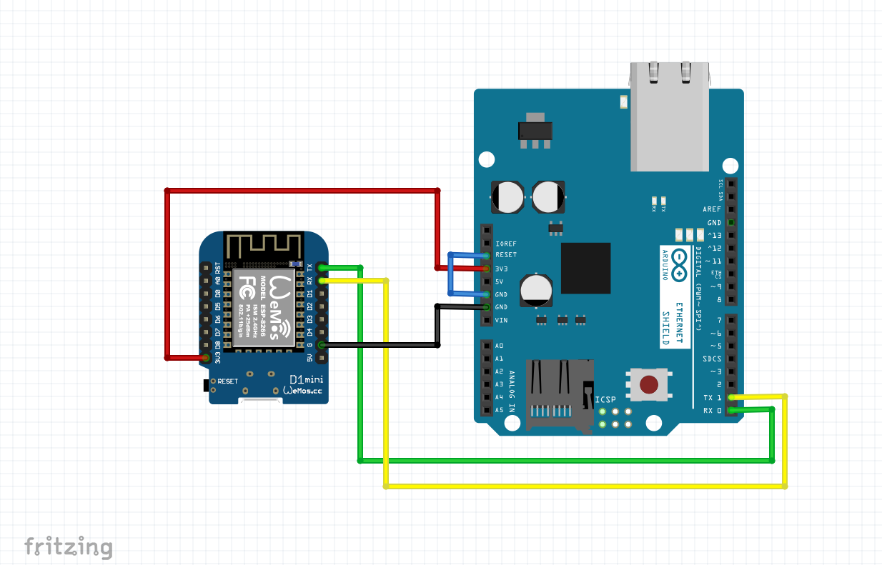
ESP32 Programming Circuit:
Face Mask Detector 16

Slide 17
Software Details: Algorithms
A source code is required for this system to work. This code is needed to insert in ESP32 CAM module using Arduino Uno.
Face Mask Detector 17

Slide 18
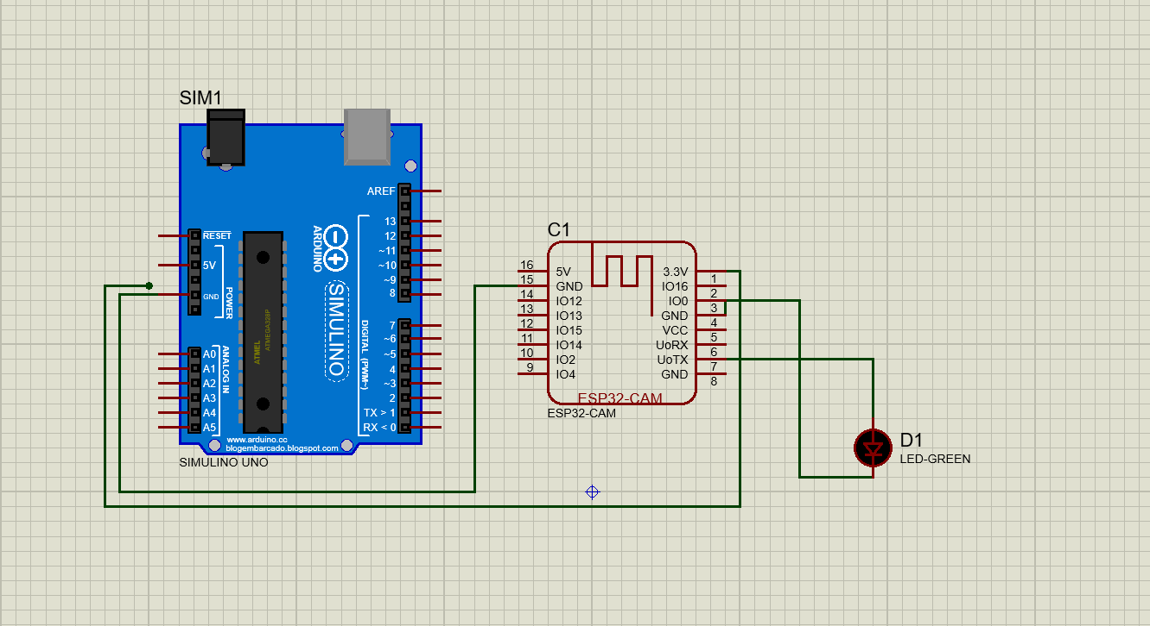
Development of System:
Simulation
Face Mask Detector 18

Slide 19
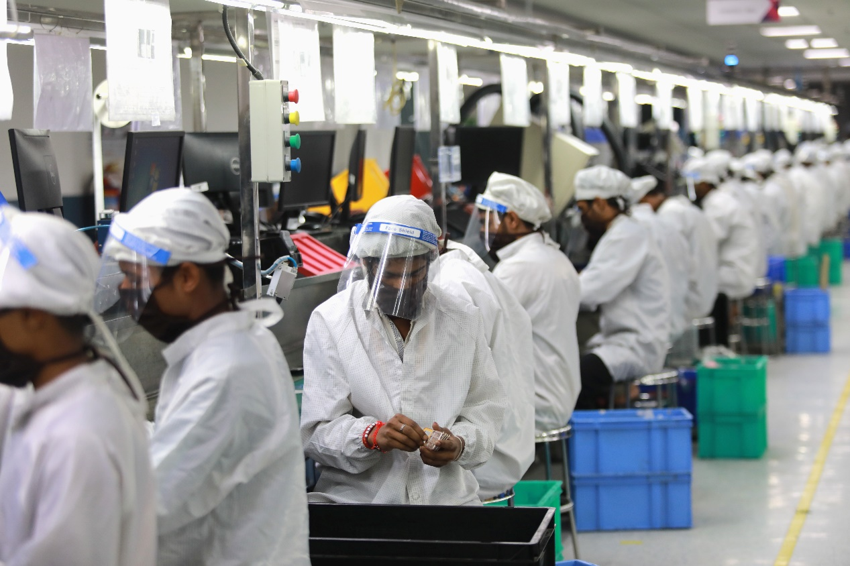
Applications of Project:
In Companies and Factories
Face Mask Detector 19

Slide 20
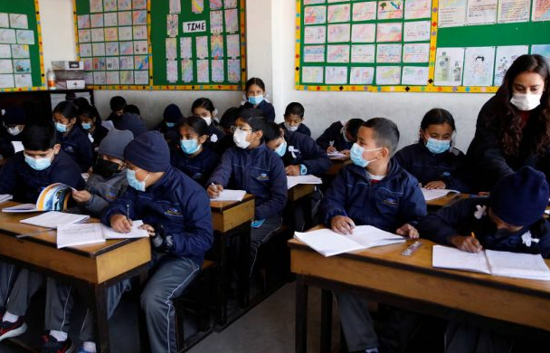
Applications of Project:
In Schools and Colleges
Face Mask Detector 20

Slide 21

Applications of Project:
In Hospitals
Face Mask Detector 21

Slide 22
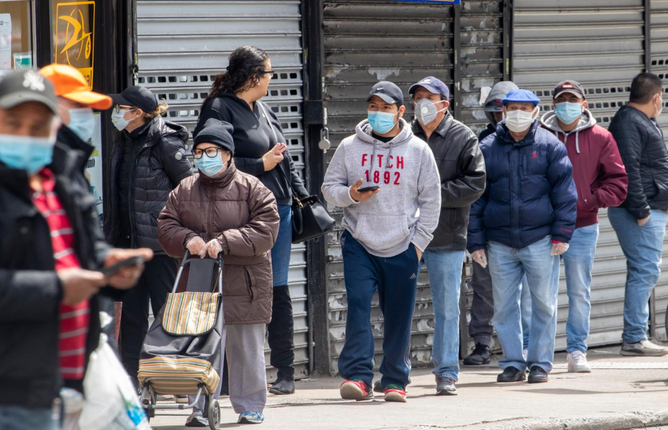
Applications of Project:
In Shops and Malls
Face Mask Detector 23

Slide 23
Cost Estimation
Sr . No. | Component Name | Price (Rs)
1. | Arduino Uno | 866
2. | ESP32 CAM | 790
3. | 9V Battery | 20
4. | Green LED | 5
5. | Zero PCB | 40
6. | Battery Connector | 10
7. | Connecting Wires | 40
8. | Adapter | 75
Total price of this project is 1840 Rs.
Face Mask Detector 3

Slide 24
Advantages
It is small in size.
Highly efficient and reliable.
Autonomous.
Face Mask Detector 24

Slide 25
Scope of Project:
It can be used as one of the major prevention devices used to fight with COVID-19. Hence it can be used in any type of building or place where public gathers.
In future, it can be used in hospitals and medical institutes.
Face Mask Detector 25

Slide 26
Conclusion:
Face Mask Detector system is very useful tool in this pandemic situation. It is difficult to check every person’s face mask where public has gathered. This tough, tedious and high-risk task can be made easy by using this system.
It can be used in any type of building or place where public gathers in large number. It can be mounted on wall or placed in front of door of any room, so it will minimize the risk of infection as it separate outs people who are not wearing a mask.
Face Mask Detector 26

Slide 27
References:
[1] Yukai Shi; Guanbin Li; Qingxing Cao; Keze Wang; Liang Lin,
“Face Hallucination by Attentive Sequence Optimization with Reinforcement Learning,” TPAMI, 2019.
[2] Tanvir Ahmed; Prangon Das; Md. Firoj Ali; Md- Firoz Mahmud, “A Comparative Study on Convolutional NeuralNetwork Based Face Recognition,” ICCCNT, 2020.
[3] Truong Quang Vinh; Nguyen Tran Ngoc Anh, “Face Mask Detector with YOLOv3 Algorithm & Haar Cascade Classifier,” ACOMP, 2020.
[4] M Rohini; K.R Naveena; G Jothipriya; S Kameshwaran; M Jagadeeswari, “A Comparative Approach To Predict Corona Virus Using Machine Learning,” ICAIS, 2021.
[5] Wuttichai Vijitkunsawat; Peerasak Chantngarm, “Study of the Performance of Algorithms for Face Mask Detection,” InCIT, 2020.
Face Mask Detector 27

Slide 28
Thank you !!

